Slide 1
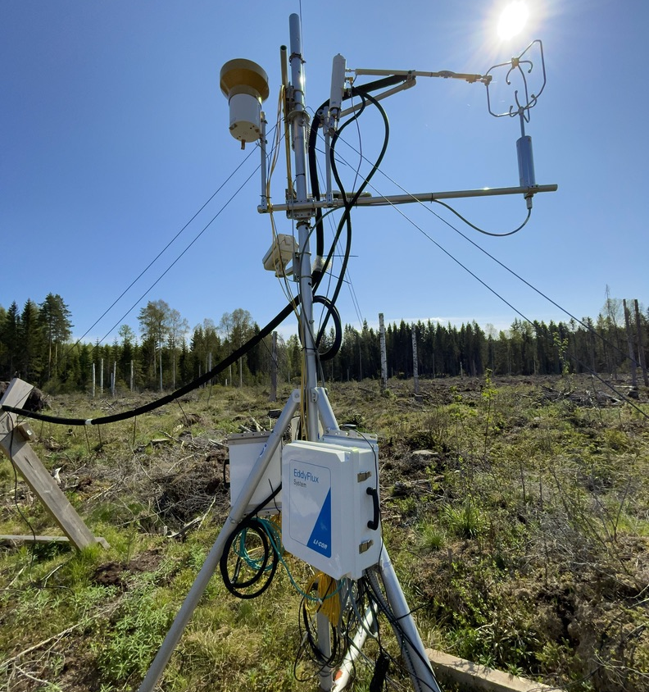

Northern European Forests’ carbon balance and management disturbances: the tale of the direct flux measurements
Samuli Launiainen¹, Toprak Aslan² & Juha Heikkinen¹
¹Natural Resources Institute Finland
²Finnish Meteorological Institute
Ränskälänkorpi clear-cut tower on fertile drained peatland, Southern Finland. Operated by Luke 2021→
Notes:
Note: If the image placeholder rotates when placing an image, do this:
1) Undo
2) Open the image in any image processing program (Paint etc.)
3) Save the image
3) Place the image again to your presentation
This problem occasionally happened when inserting a vertical image

Slide 2
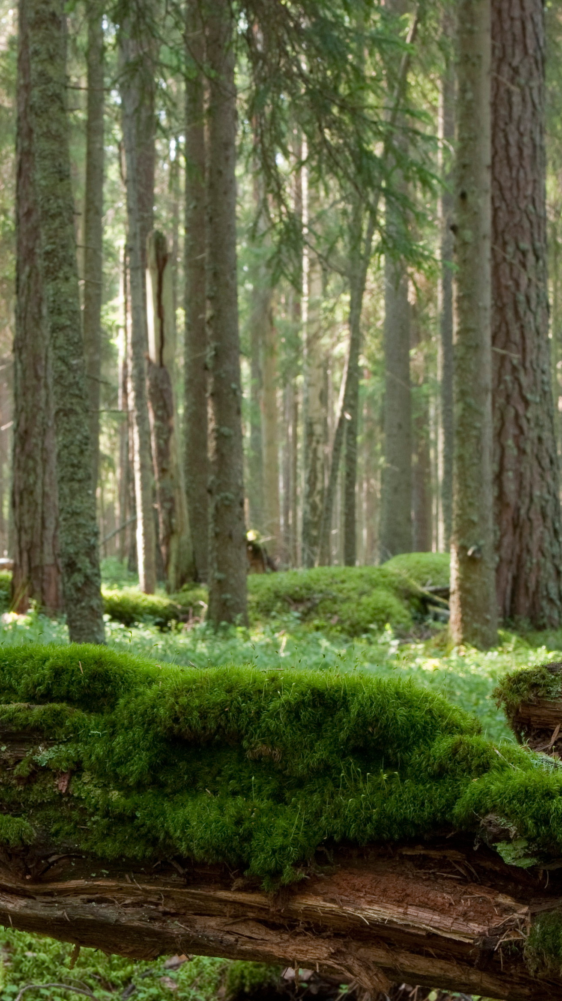
Why?
Forests:
face multiple demands – providing carbon storage, climate regulation, income and well-being
Northern Europe:
forests and forestry major land use & crucial for national climate targets
Active flux community
Reasonably uniform – species, soils, climate, management
Synthesis:
So far very few (Lindroth et al. 2008, 2020)
So far only a few sites included

Slide 3
Ecosystem (on-site) carbon balance
Atmosphere
GPP
RECO
Change in
C storage
DOC
Harvests
NEP = GPP - RECO
Net ecosystem productivity NEP = - NEE from eddy-covariance
Ecosystem respiration RECO
f(Temperature), inferred based on night-time NEP
Gross primary productivity GPP = NEP + RECO

Slide 4
What is out there?

Slide 5
Forest C balance by eddy-covariance?
Northern European forests
Minimum 1 year of NEP data
Published & citable
ICOS warm winter dataset
FluxNet 2015
Literature review
Site attributes → species, (LAI), soil type, site type, management history
Habitat, Köppen climate
ERA5 Land → climate, gs length
Minimum a MSc thesis or preprint

Slide 6
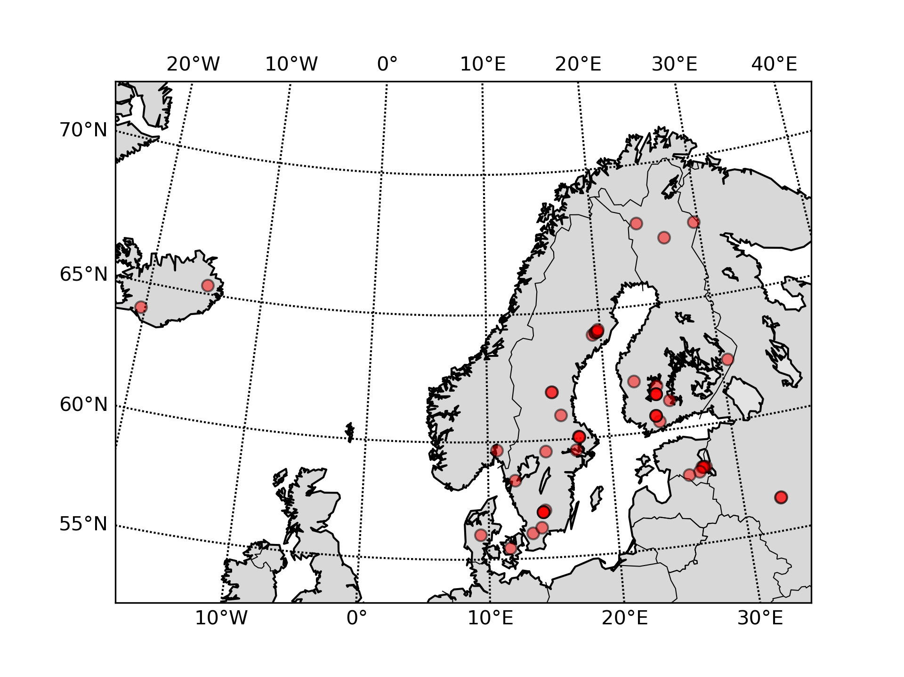
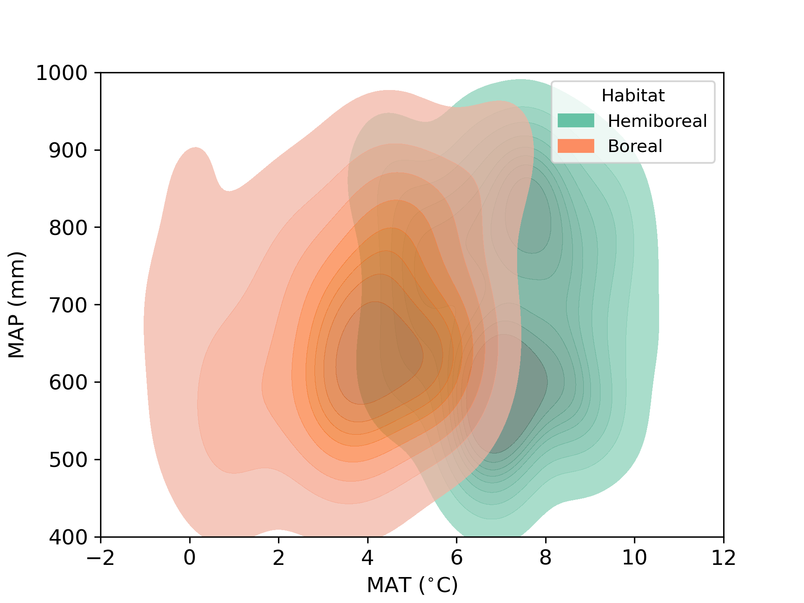
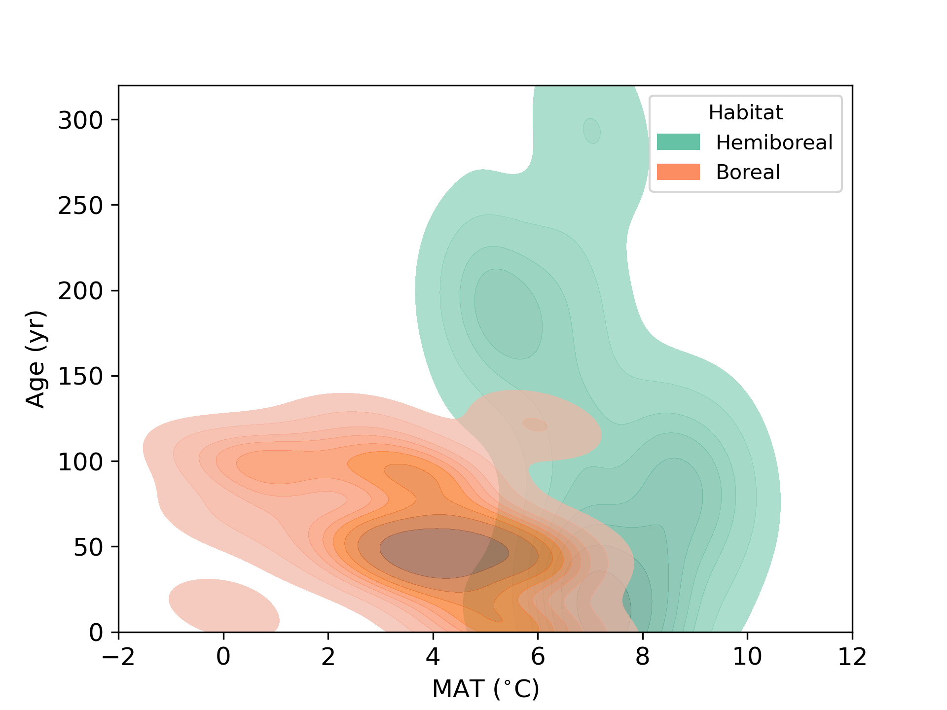
NEP:
50 sites
320 site-years
1 to 26 yr/site
GPP/RECO:
44 sites
252 site-years
1997 – 2022
Sweden 22
Finland 15
Estonia 7
Denmark 2
Iceland 2
Russia 2
Norway 1
11 peatland forests
3 plantations
2 post-fire sites
11 recent clear-cuts
3 thinned sites
2 N-fertilization
10 ICOS warm-winter
1 Fluxnet 2015
39 Literature review

Slide 7
How carbon balance vary with stand age?

Slide 8
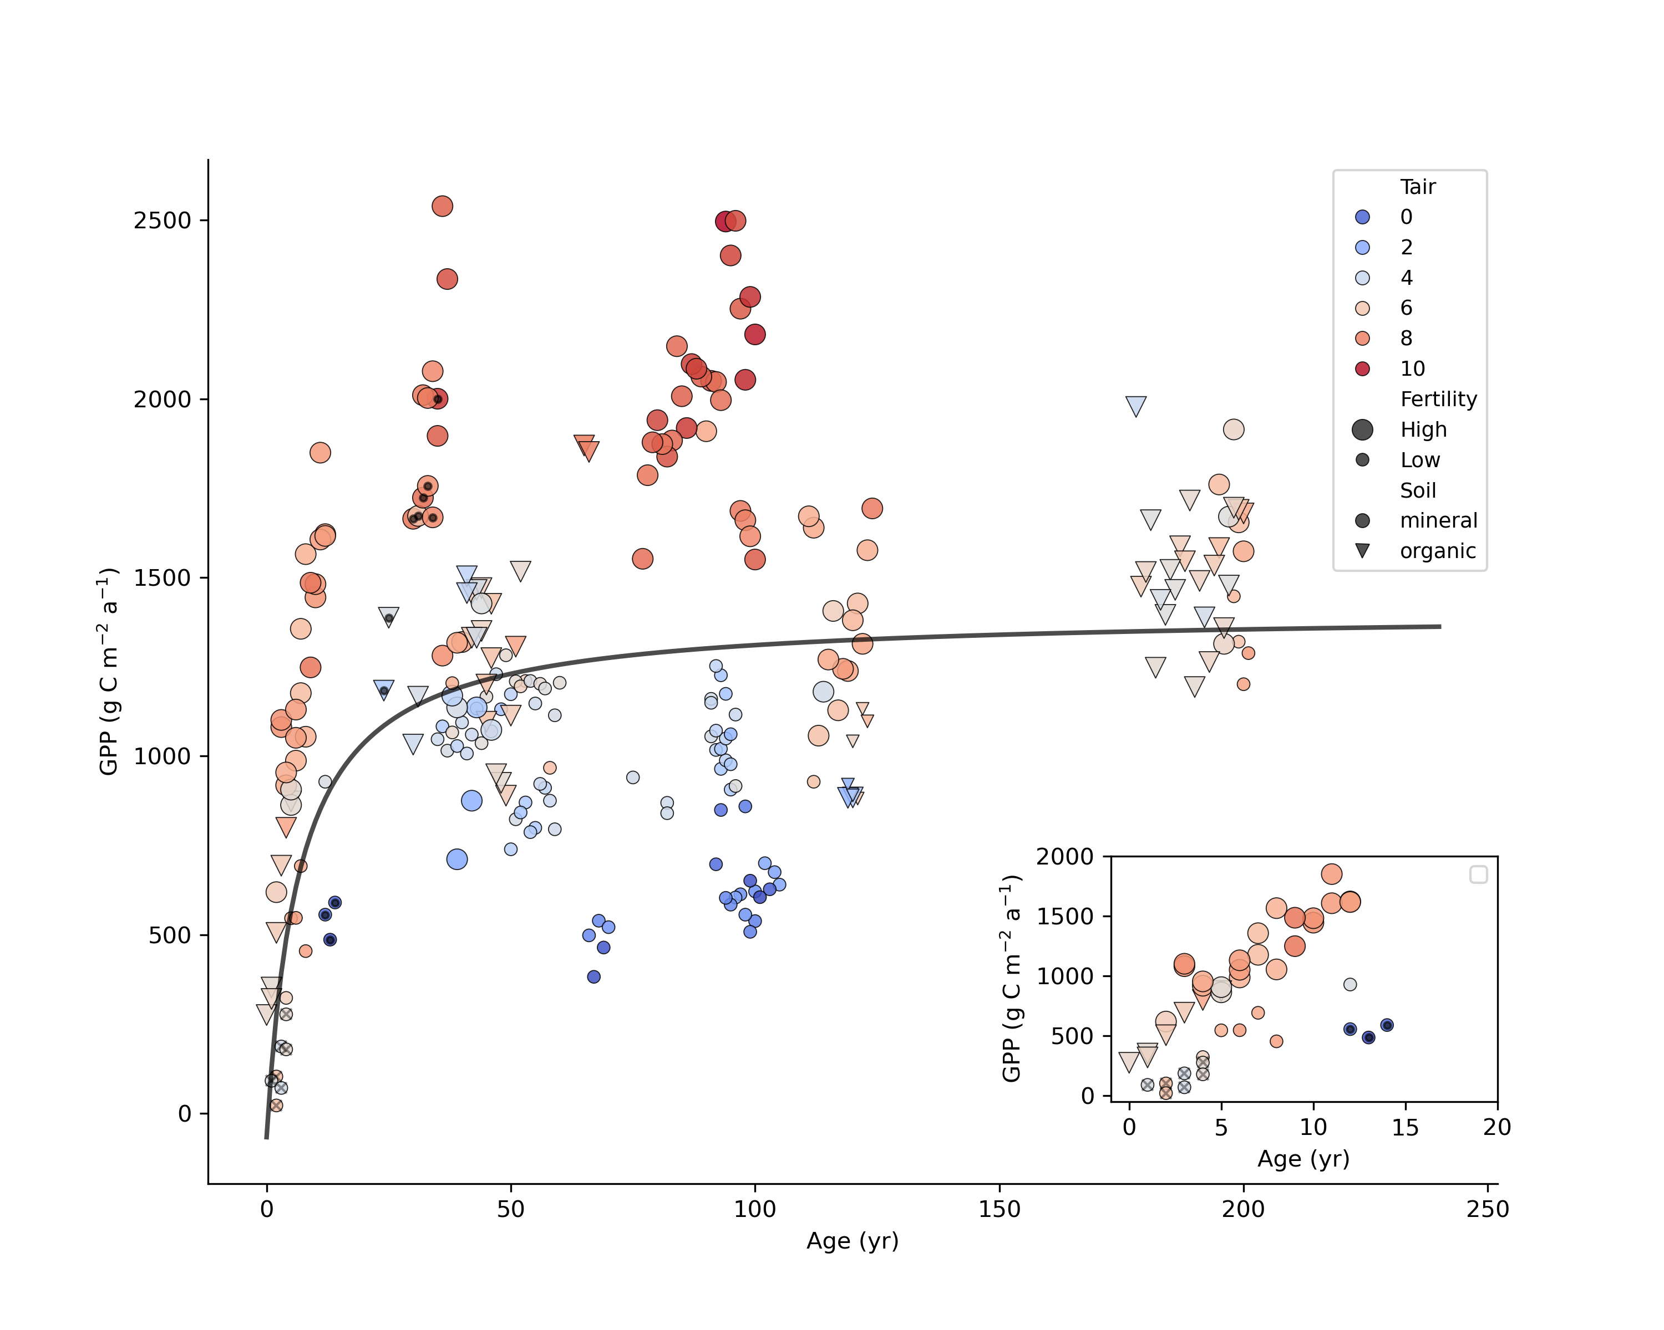
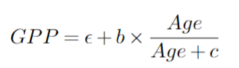
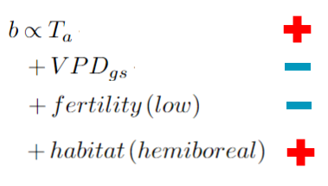
Gross-primary productivity
Age only: 17% of variance
Age, T_{a} and site attributes: 78%
GPP (g C m⁻² a⁻¹)
color = MAT
size = fertility
symbol = soil type
dot = plantation
cross-hatch = post-fire
Age

Slide 9
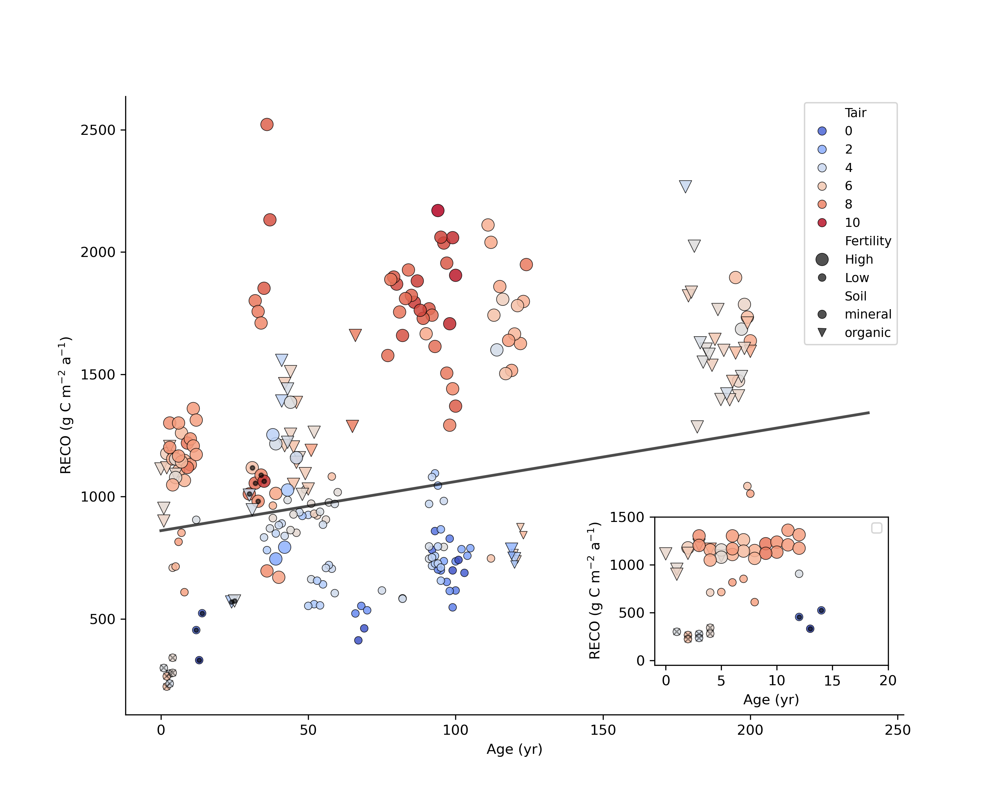
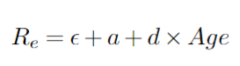
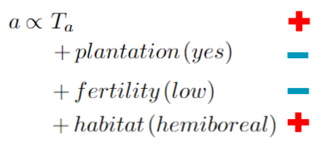
Ecosystem respiration
Age only: 14%
With T_{a} and site attributes: 71%
Reco (g C m⁻² a⁻¹)
color = MAT
size = fertility
symbol = soil type
dot = plantation
cross-hatch = post-fire
Age

Slide 10
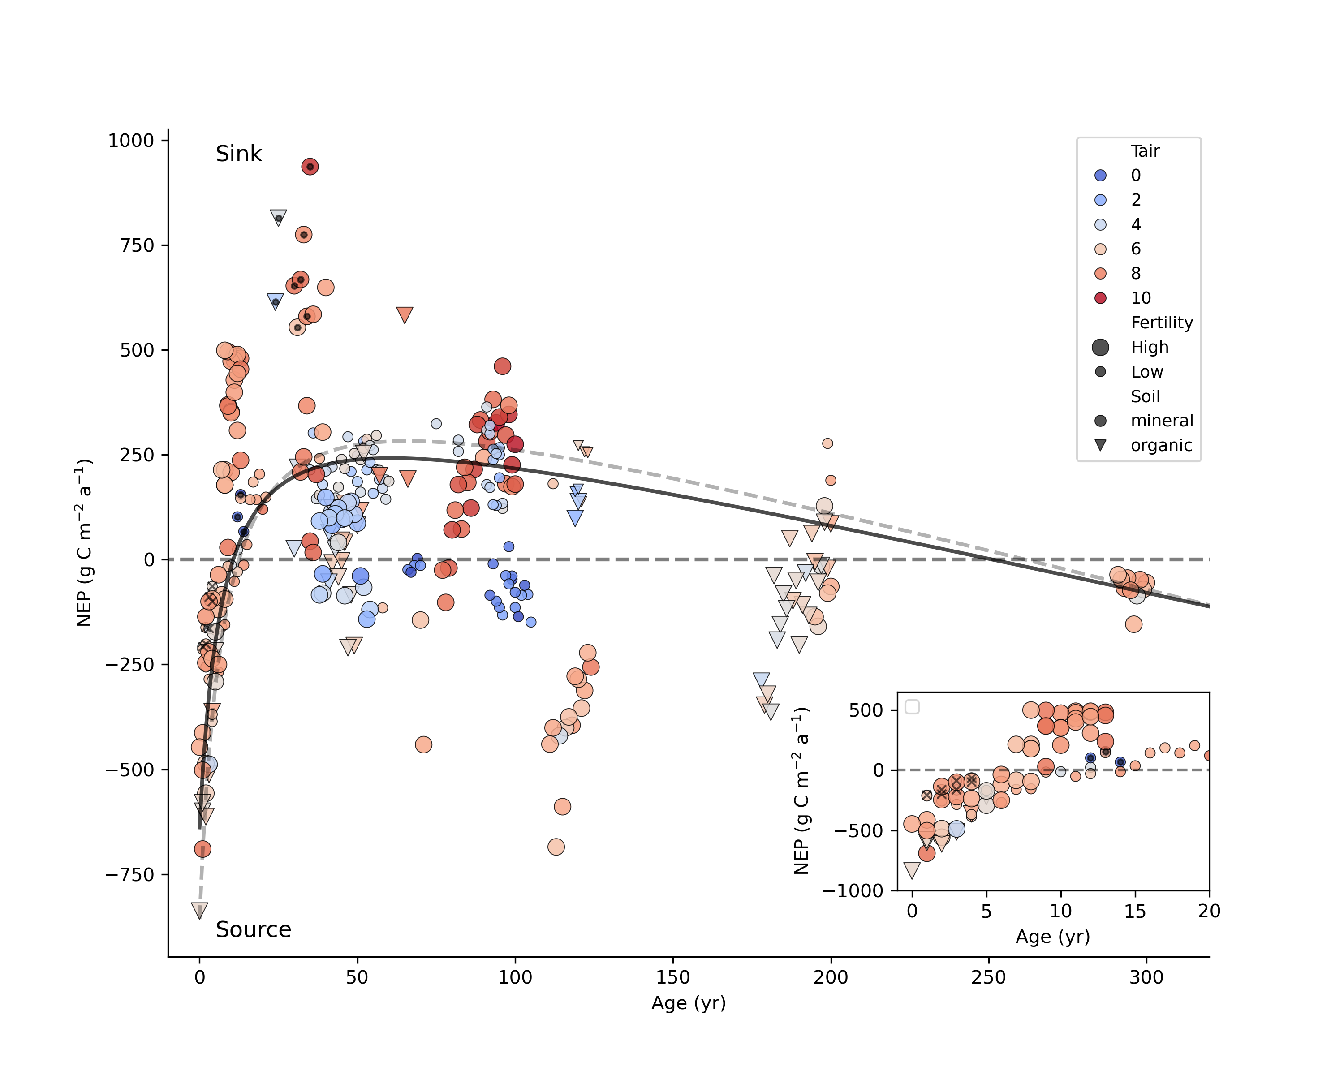
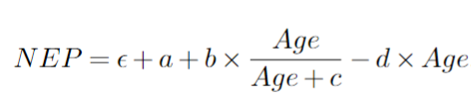
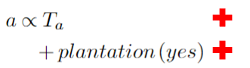
NEP – on-site carbon balance
Age only: 19 % of variance
Age, T_{a} and plantation: 39 %
NEP (g C m⁻² a⁻¹)
color = MAT
size = fertility
symbol = soil type
dot = plantation
cross-hatch = post-fire
Age

Slide 11
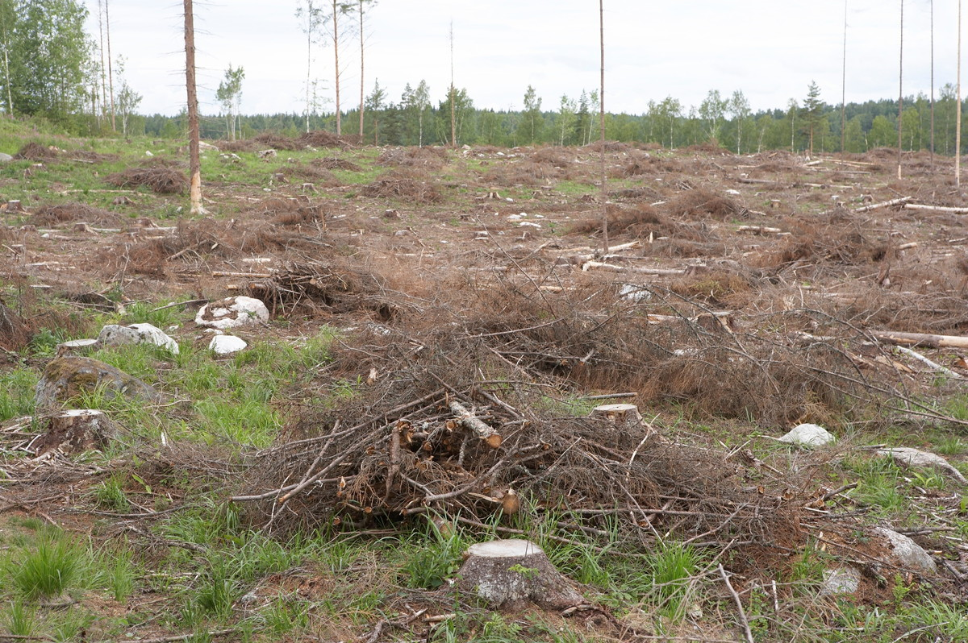
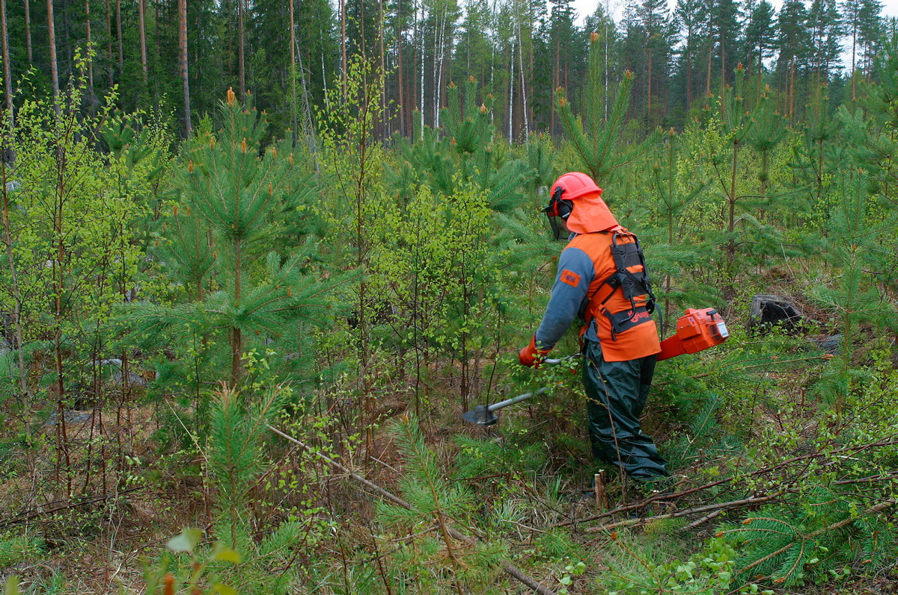
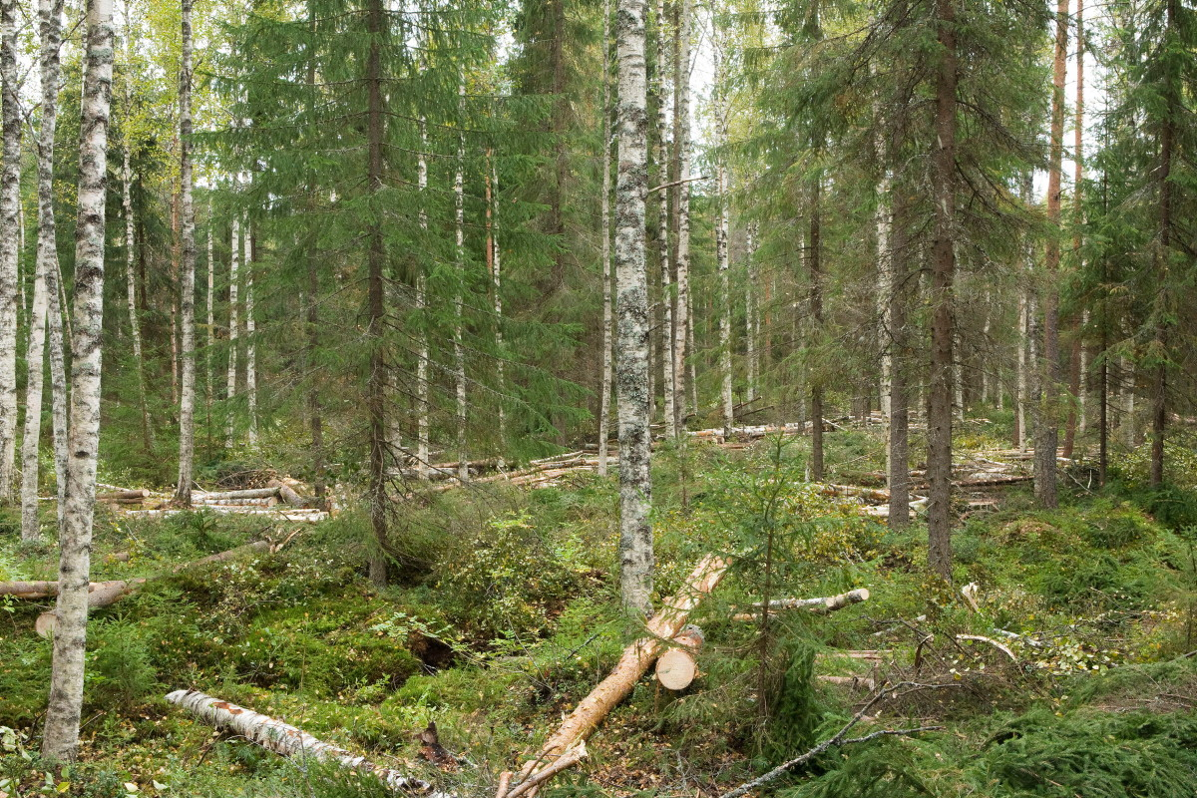
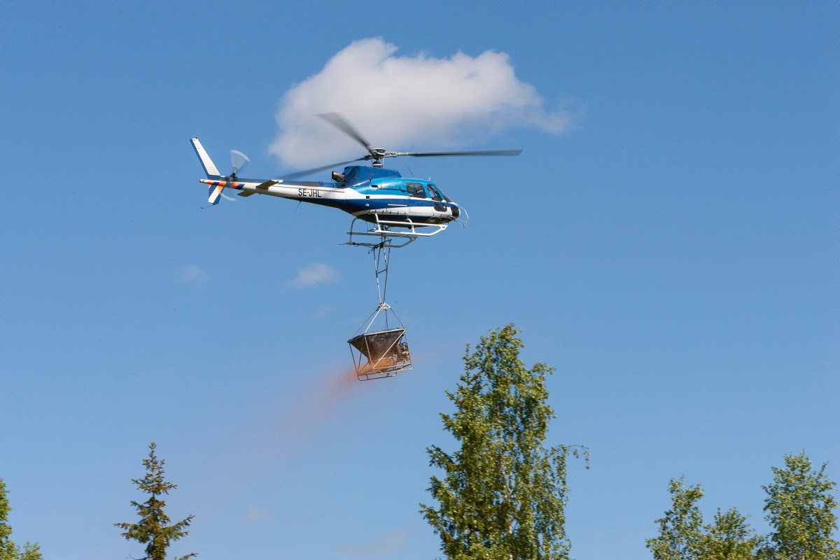
How forest management practices affect C balance?

Slide 12
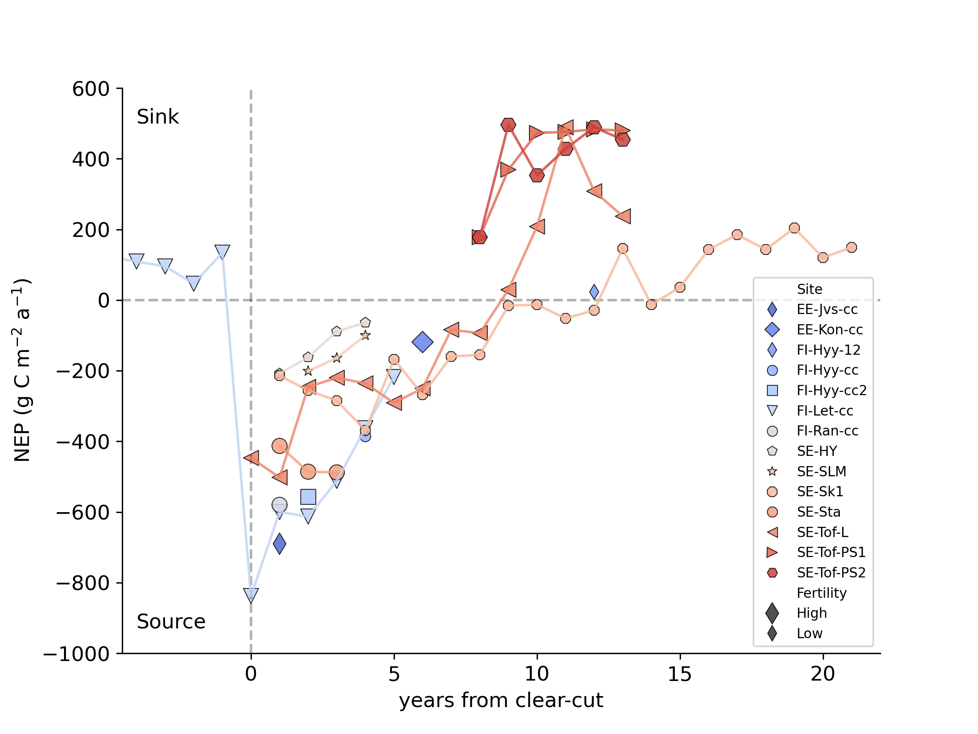
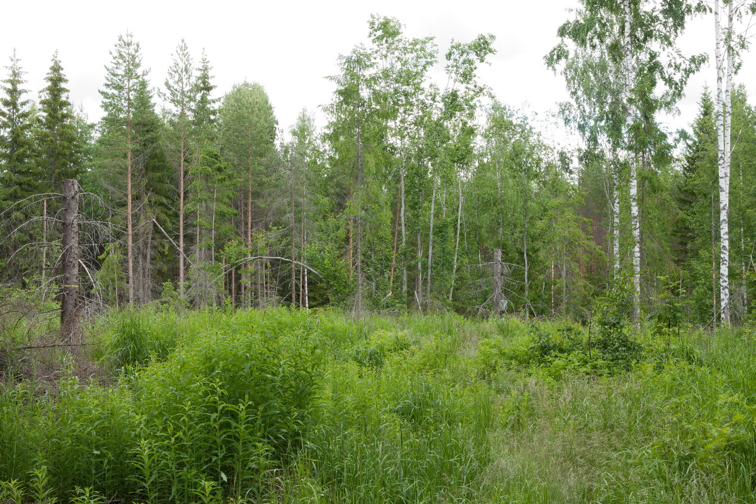
Rapid NEP recovery after clear-cutting
From source to sink <10 year post-harvest
Initial emissions depend on site fertility and amount & fate of cutting residues
Significant GPP immediately after clear-cutting
Fast GPP recovery drives NEP dynamics
Flush of deciduous seedlings, grass, herbs, shrubs
peatlands
post-fire
Kolari et al. (2004); Ahmed (2019); Korkiakoski et al. (2023); Tikkasalo et al. (2024);
Kelly et al. (2024); Grelle et al. (2023, 2012); Uri et al. (2019); Rebane et al. (2024)

Slide 13
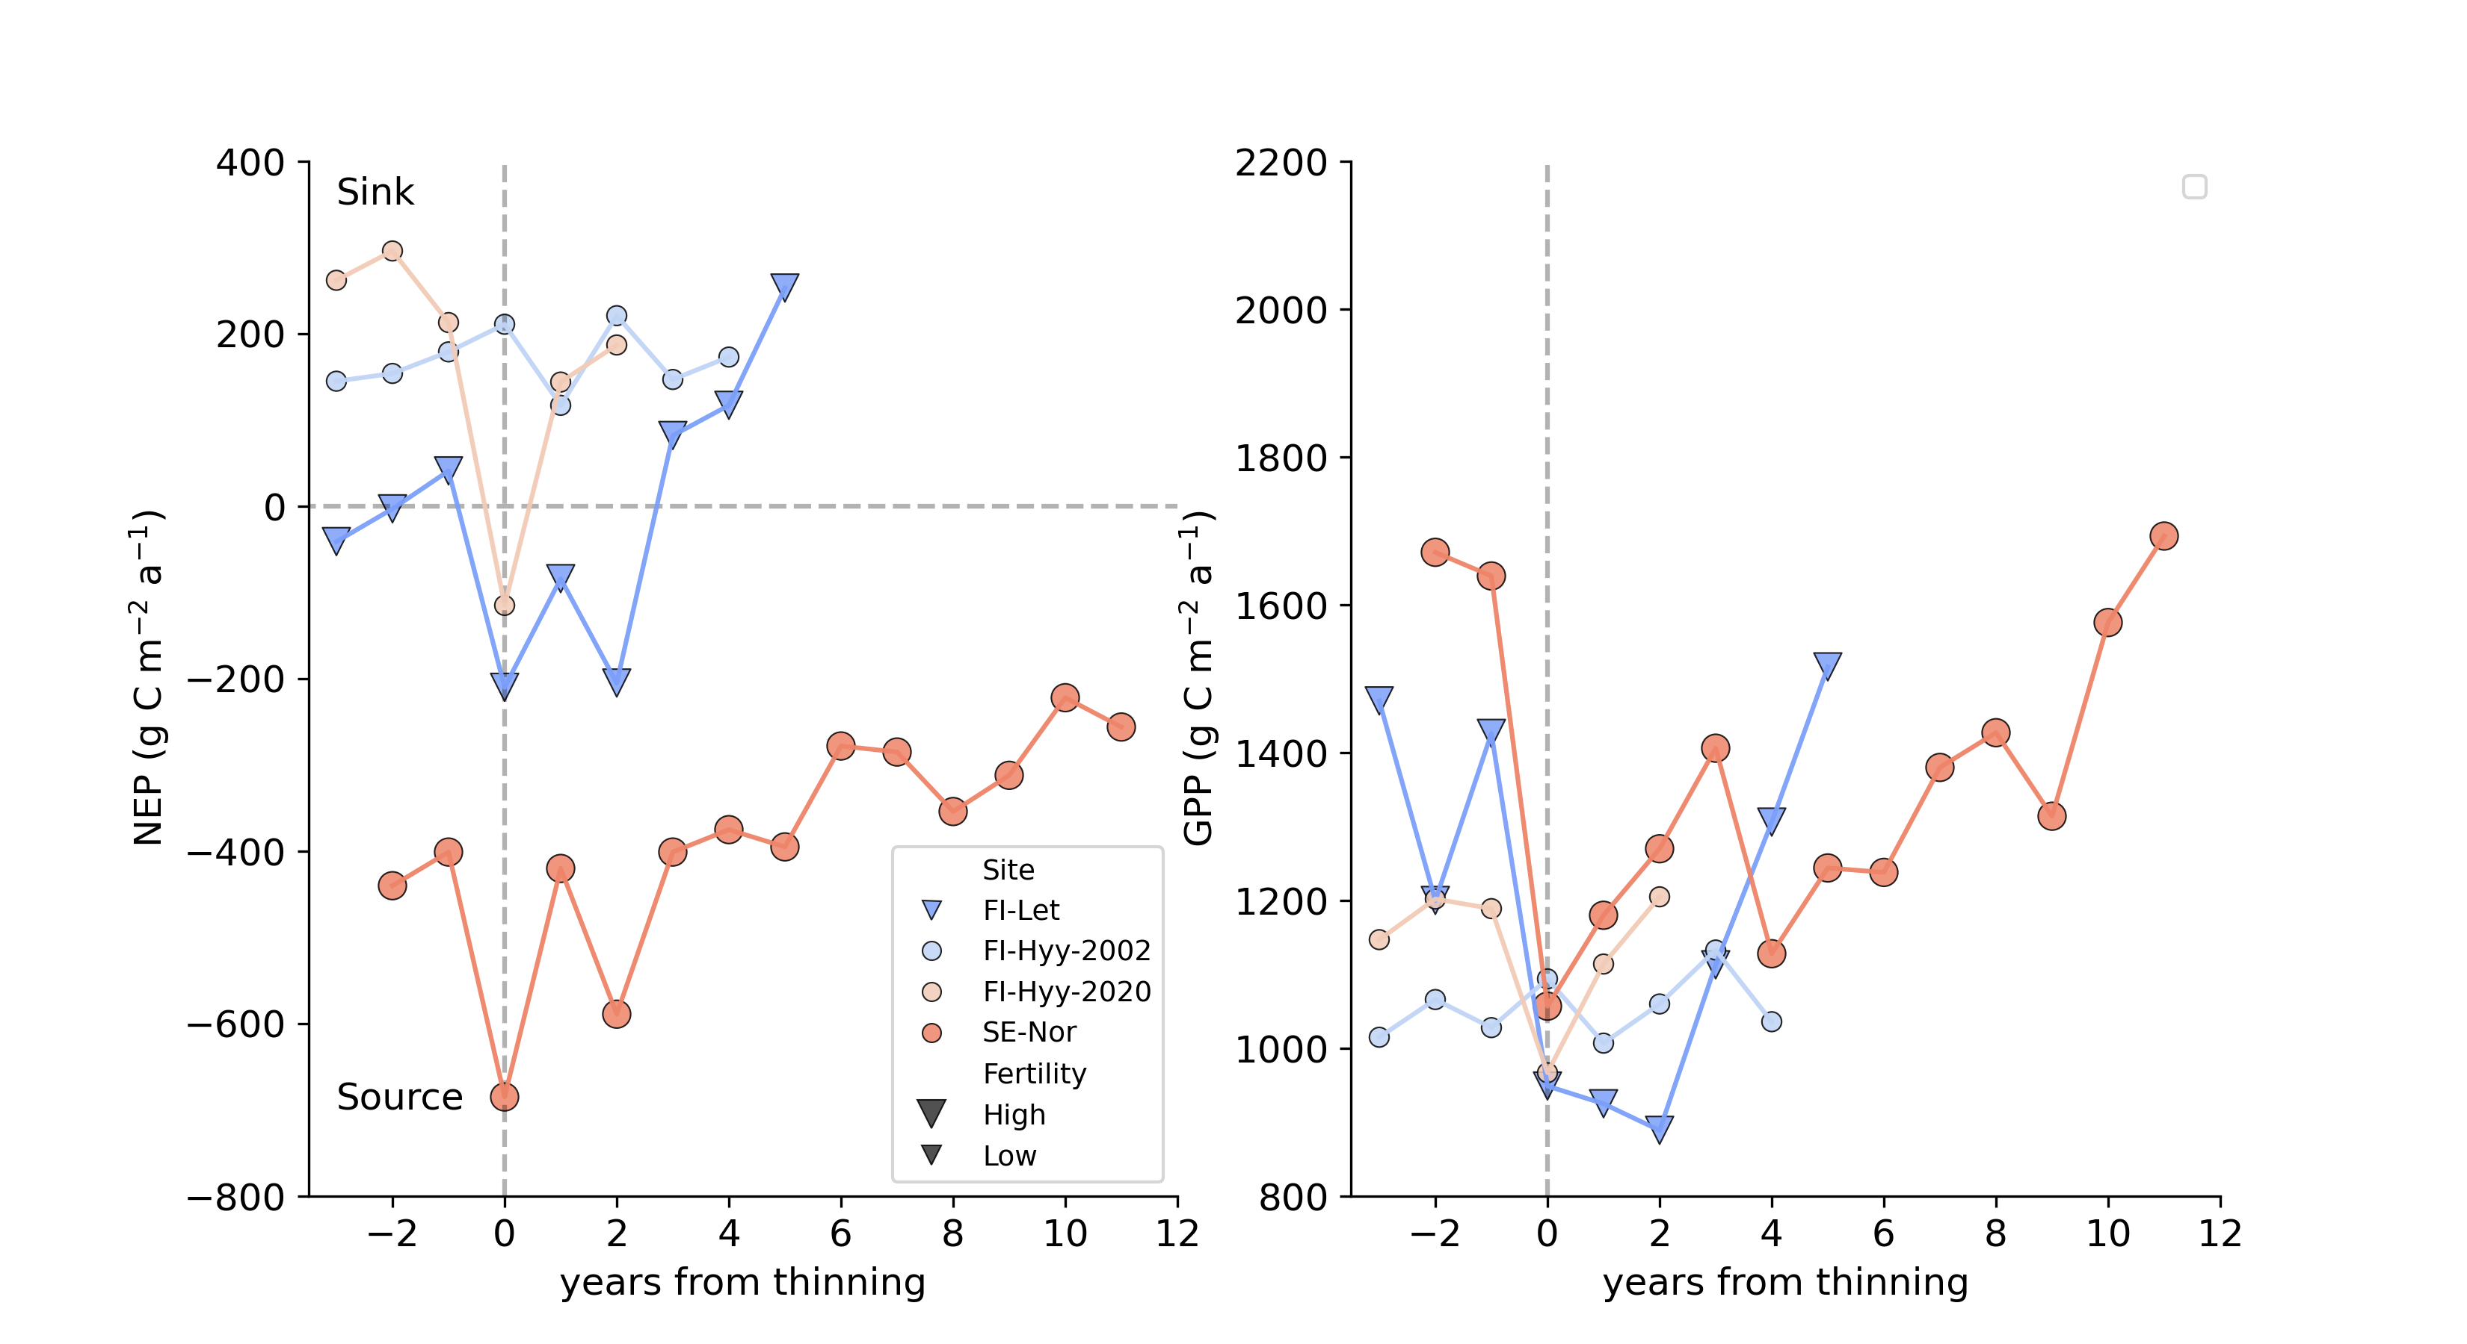
Thinning response is short-lived
Short-term drop in NEP is due to GPP response
GPP reduction (%) always smaller than removed LAI (%)
Light (water, nutrient) availability
Rapid GPP and NEP recovery
Fertile, dense stands (FI-Let & SE-Nor):
Reco decreases after thinning
Thinning improves on-site carbon sink?
Site | Removed LAI (% ) | Removed BA (m²ha⁻¹) | Site details
FI-Let | 50 | 25 | Mixed species, fertile drained peatland (Korkiakoski et al. 2023)
FI-Hyy 2002 | 25 | 6 | Mixed conif., 1st thinning, infertile mineral soil (Vesala et al. 2005)
FI-Hyy 2020 | 40 | 12 | 2nd thinning (Aslan et al. 2024)
SE-Nor | 50 | 10 | fertile old spruce, mineral soil, high organic content (Lindroth et al. 2018)

Slide 14
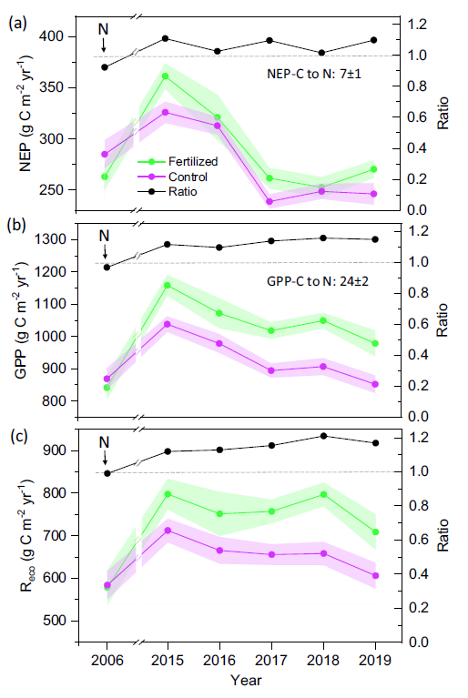
N fertilization improves NEP
Rosinedal, N. Sweden
Scots pine on low-fertility mineral soil
N-fertilization 100 kg N ha⁻¹ a⁻¹ (2006-2011), 50-60 kg N ha⁻¹ a⁻¹ (2012-2019)
Long-term N-fertilization increases both GPP and RECO.
Small(er) positive effect on NEP
Zhao et al. (2022) Agric. For. Met.
https://doi.org/10.1016/j.agrformet.2022.109112

Slide 15
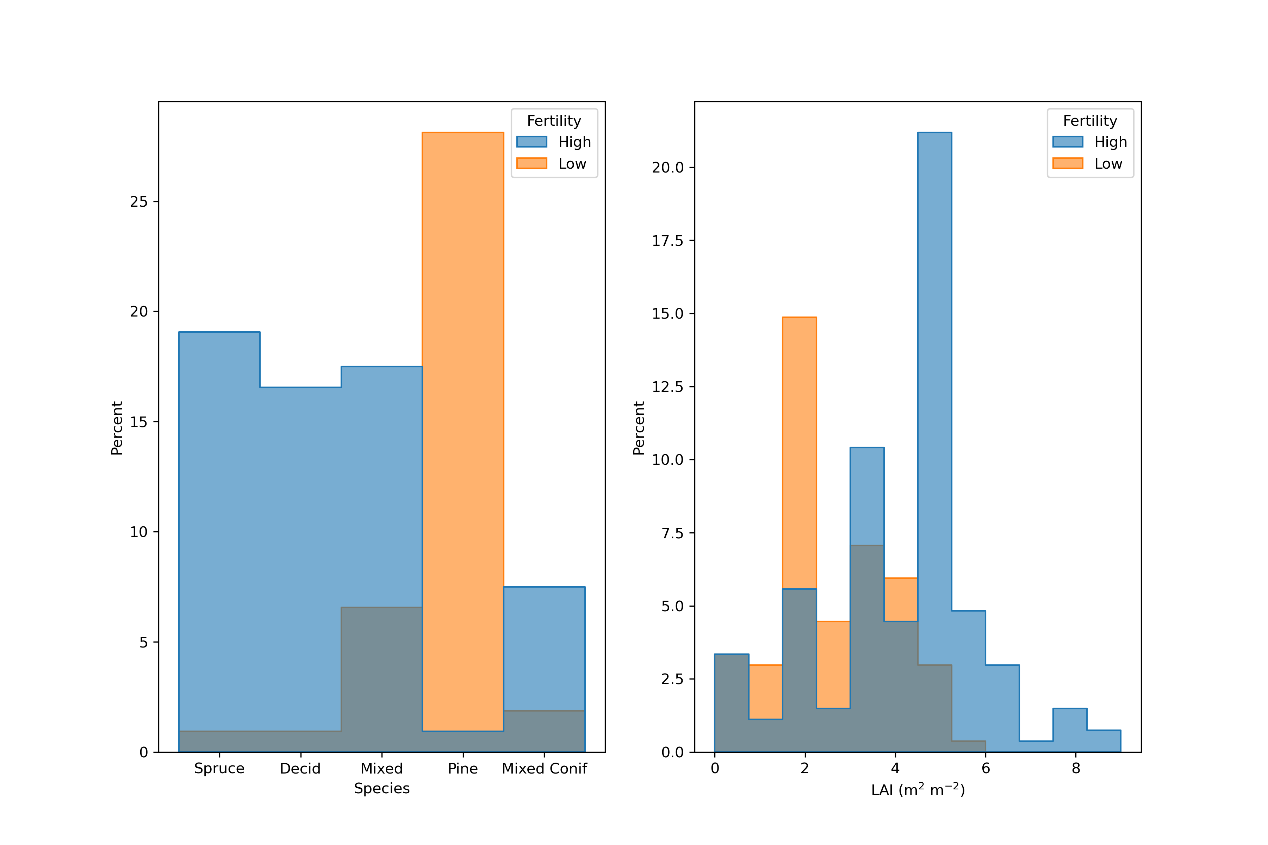

Summary – NEP, GPP and Reco variability
NEP
Young forests strong C sources, old-growth C neutral or weak sources
Fast recovery from stand-replacing disturbance (< 10 yrs to C neutrality)
Soil type (mineral / organic) has no clear impact
Low RECO and high NEP on former agric. lands / pastures → afforestation
But - large variability
GPP and RECO
Increase with Age & MAT (~growing season length, radiation sum…)
High at fertile sites (~nutrients, water, species composition, LAI, soil C stock,…)

Slide 16
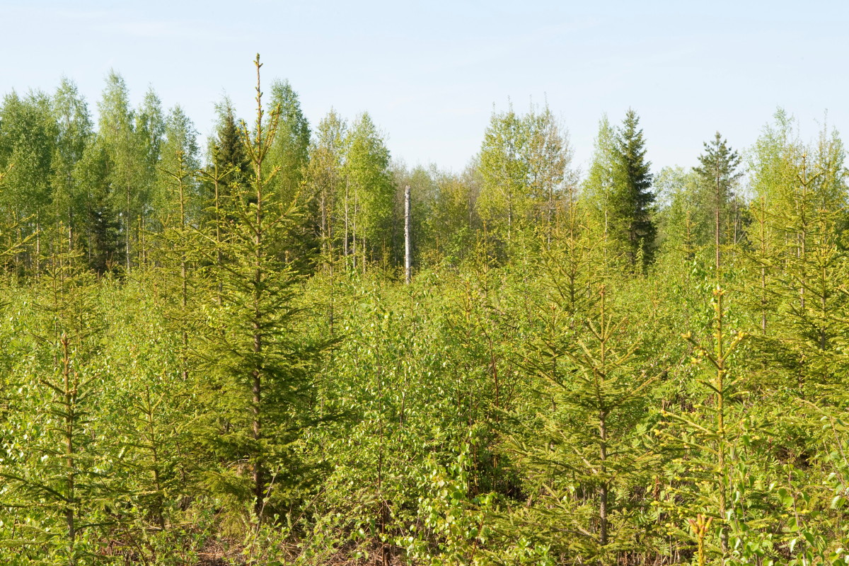
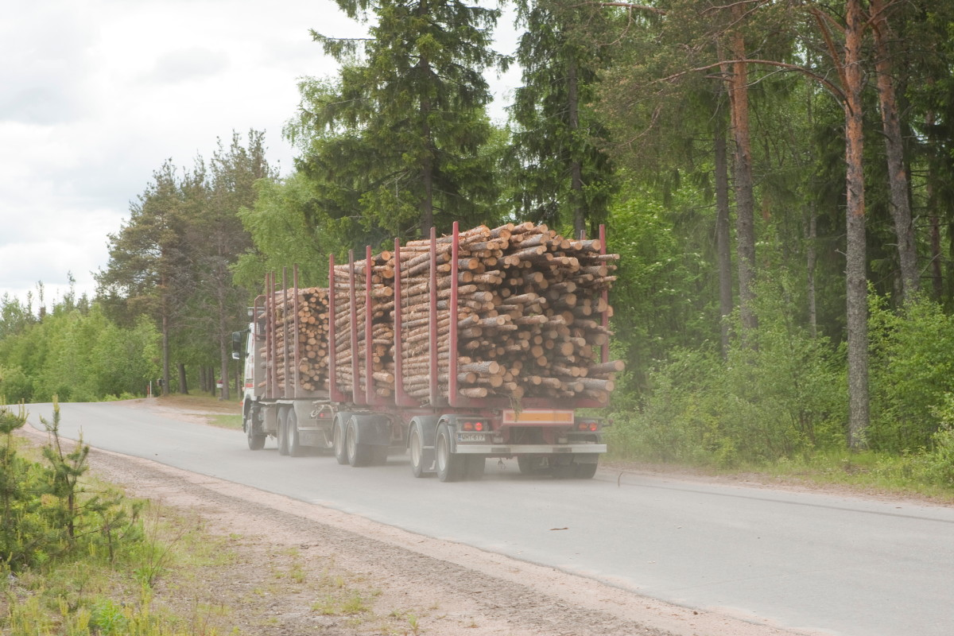
Message – forest management
Forestry operations act primarily on GPP
Rapid disturbance recovery
We must re-think the role of ”green slime” on C sink
Peatland forests are not that different from mineral soil stands
Impact to on-site C balance (NEP) only part of the story – the fate and lifetime of harvested C storage
Three decades of flux measurements have contributed little for improving forest management

Slide 17
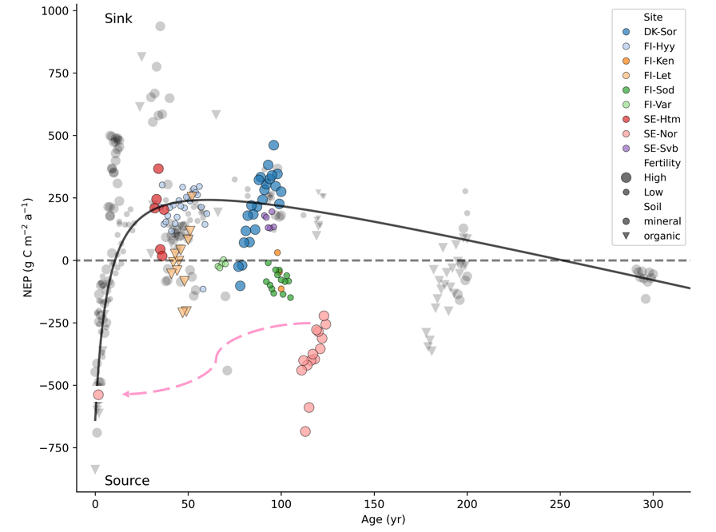
Implications – ICOS & flux community?
ICOS Ecosystem Class 1, 2 and Associate stations
Ecossystem station network == mid/late rotation coniferous forests
From management perspective meaningless to monitor
Risk of bias – C budgeting, model training, regional upscaling
How to learn more from the few ICOS sites?
We tend to neglect non-community studies & old data
Combining ’Northern European Forest Flux’ legacy data necessary
?

Slide 18


Contact: samuli.launiainen@luke.fi Thank you!
LS-Hydro (2023-2027): From forest structure to hydrological function – merging dense EO data and process-models
PREFER (2022-2026): Precision nutrient management - a tool for mitigation of climate change and environmental loading in boreal forestry
GreenFeedBack – Greenhouse gas fluxes and Earth system feedbacks

Slide 19
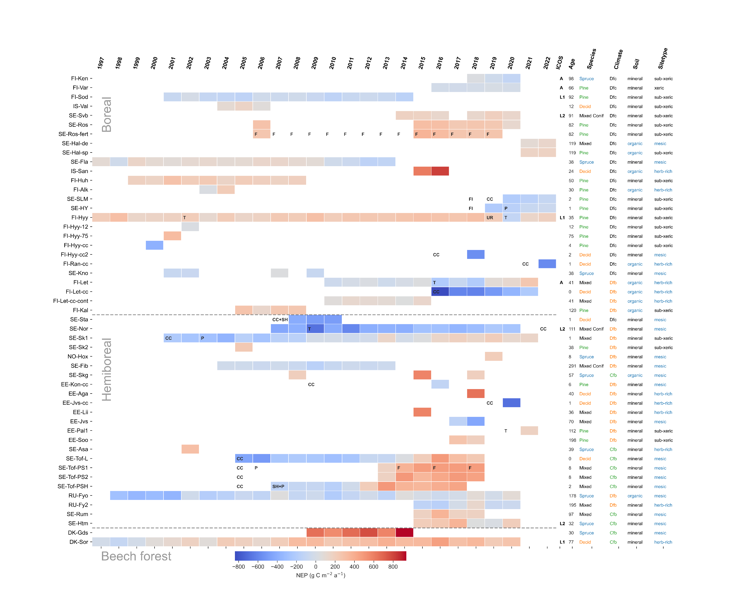
NEP (g C m⁻² a⁻¹)

